Slide 1
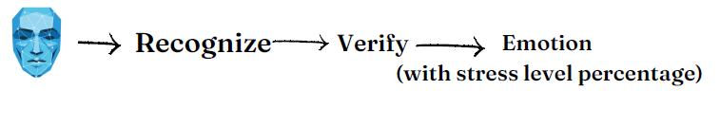
FACIAL EMOTION RECOGNITION
Using CNN
Team Members:
B.Padmavathi(319126511074)
K.Tripura(319126511087)
B.V.SandeepKumar(320126511L11)
B.Kasi(319126511072)
Project Guide: Dr. V. Suresh

Slide 2
AGENDA
Introduction
Problem Statement
Uniqueness of the Proposed System
Proposed Framework
Sample Code & Results
Evaluation Metrics
Code & Results
Conclusion
References

Slide 3
Introduction:
Facial emotion recognition (FER) systems have become increasingly popular due to their potential applications in various domains, such as human-computer interaction, security, and healthcare. FER systems aim to automatically detect and recognize human emotions based on facial expressions. The system typically involves a combination of image processing, machine learning, and computer vision techniques to extract relevant features from the facial images and classify the emotion category. This project provides an overview of the FER system, including its working principles, applications, challenges, and recent advances.
We discuss the importance of FER systems and their potential impact on various fields, highlighting the need for further research in this area to improve their accuracy and robustness.

Slide 4
Problem Statement:
The goal of this study was to use technology to track the subject's stress level by new modern methodology in order to overcome the old school methods to detect the stress.
These projects would eliminate the concern of doctor manually since these output data would be monitored by doctor himself at remote location and also eliminates the old school paper methods.
Objectives :
To develop a face expression recognition system.
To experiment machine learning formula in pc vision fields.
To sight feeling so facilitating Intelligent Human-Computer Interaction.

Slide 5
Uniqueness of the proposed system:
We observe that all the existing systems in the real-time are generally two different systems. One which displays only emotion or emotion with percentage. The other is the one which recommends the remedies for it.
But, here in our project or the proposed framework , we try to combine the advantages of both these systems together giving a better output / result. This makes the proposed system unique and beneficial.
As mentioned in the problem statement, we can eliminate all the old-school methods and step ahead with the new one through this system.

Slide 6
Proposed Framework:
The System consists of 3 main steps:
Firstly, we spot the face region from the non-inheritable image here .We use native abstraction position or displacement of specific points and regions of the face (pre-process to minimize the environmental and different variations within the image)
Secondly, we extract expression options here we have to two main classes of feature extraction they are Geometric based and Appearance based .
Geometric based feature extraction : Geometric relationships equivalent to angles and positions between completely different facial components like nose, eyes, ears. The face expression is decided by the movement of the facial points.
Appearance based extraction: The features are chosen to be the pixel intensity values in an image of the object and it captures the spatial shape of face during actions.
Thirdly , the classifier provides the output of the expression that is recognized.
Finally, we display the percentage level of stress based on the emotion displayed , which stays constant throughout. The suggestion or recommendation will be displayed to give the project completeness.

Slide 7
Sample Code through Google Colab:
https://colab.research.google.com/drive/1-p53Ct0d1R2gCz_PCZReVRQY9NdtD7c4?usp=sharing

Slide 8
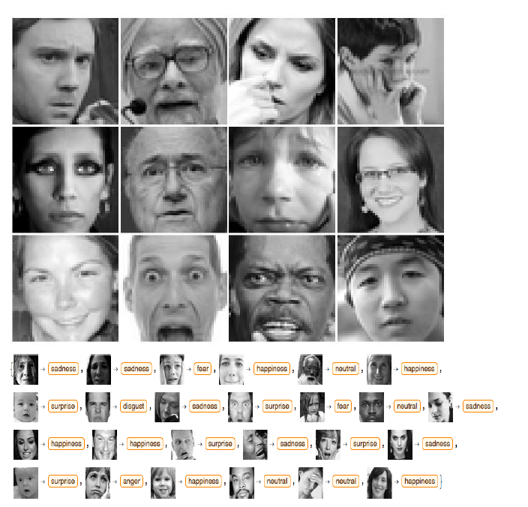
Sample Results:
Images from Dataset FER2013

Slide 9
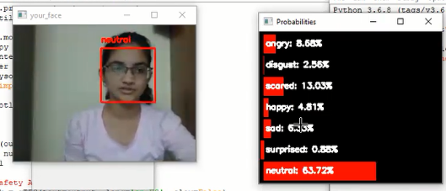
Sample Output:

Slide 10
Evaluation Metrics:
Precision: Precision estimates the prophetical price of a label, either positive or negative, reckoning on the category that it calculated; in alternative
words, it assesses the prophetical power of the formula. Exactitude is
that the proportion of properly appointed expressions in relation to
the whole range of aspects.
Recall : Recall may be a perform of its properly classified examples
(true positives) and its misclassified examples (false negatives). Recall
is that the proportion of properly appointed expressions in reference
to the whole range of expressions.
F-score : F-score may be a composite live that advantages
algorithms with higher sensitivity and challenges algorithms with
higher specificity. The F-score is equally balanced once β = one.

Slide 11
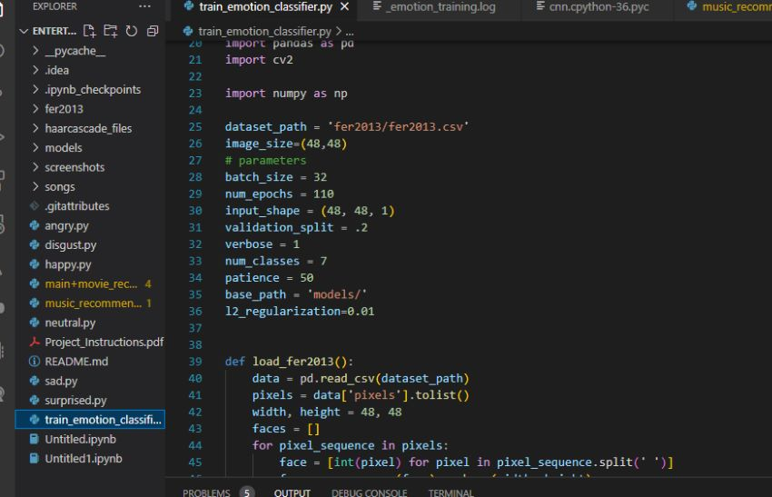
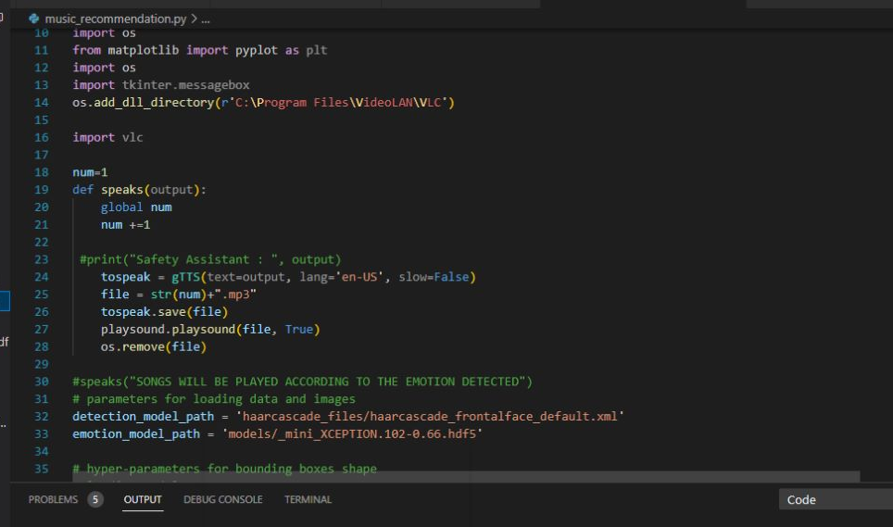
Code & Results:

Slide 12
Conclusion:
This project proposes associate approach for recognizing the class of facial expressions. Face Detection and Extraction of expressions from facial pictures is helpful in several applications, like artificial intelligence vision, video police work, digital cameras, security and human-computer interaction. This project’s objective was to develop a face expression recognition system implementing the pc visions and enhancing the advanced feature extraction and classification in facial expression recognition.
In this project, seven different facial expressions of various person’s pictures from different datasets are analyzed.Different facial expressions include 0=Anger,1=Disgust,2=Fear,3=Happy, 4=Neutral,5=Sad and 6=Suprise

Slide 13
References:
Analytics Vidhya
https://www.analyticsvidhya.com/blog/2021/11/facial-emotion-detection-using-cnn/
Towards Data Science
https://towardsdatascience.com/face-detection-recognition-and-emotion-detection-in-8-lines-of-code-b2ce32d4d5de
Science Direct
https://www.sciencedirect.com/science/article/pii/S1877050920318019

Slide 14
THANK YOU!

